Slide 1
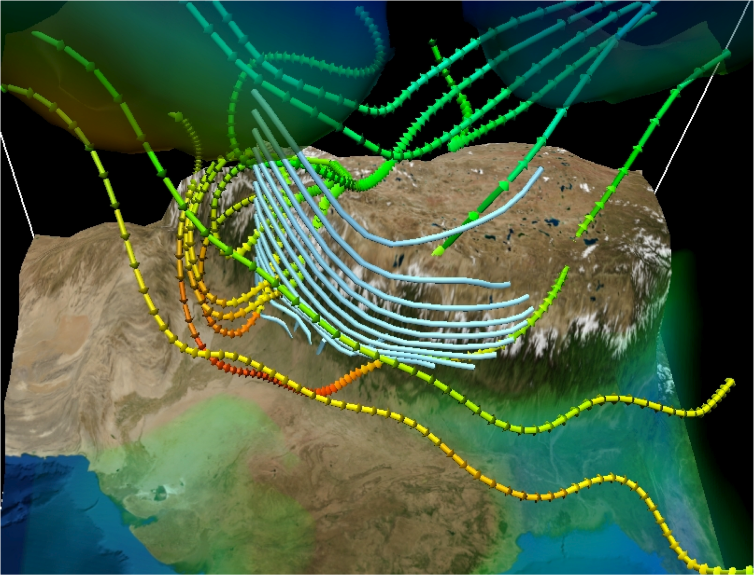
PHYS 8750 Numerical Fluid Dynamics
Fall, 2020
www.vapor.ucar.edu/gallery/image
Flow Trajectories along the Himalayan Border – Thara Prabhakaran, Indian Institute of Tropical Meteorology

Slide 2
PHYS 8750
Outline
1. Dispersion errors
2. Phase speed and group speed
3. Space filtering
1) 2nd-derivative spatial smoother
2) Higher order-derivative spatial smoother
3) Comparison with Takacs’s method
4. Revisit of Lax-Wendroff method
Class #8
1) Dispersion and Dissipation errors
2) Lax-Wendroff Scheme
3) Takacs Method (1985)
Class #9, Chapter 3.3, 3.4 (Space Filtering, Lax-Wendroff)

Slide 3
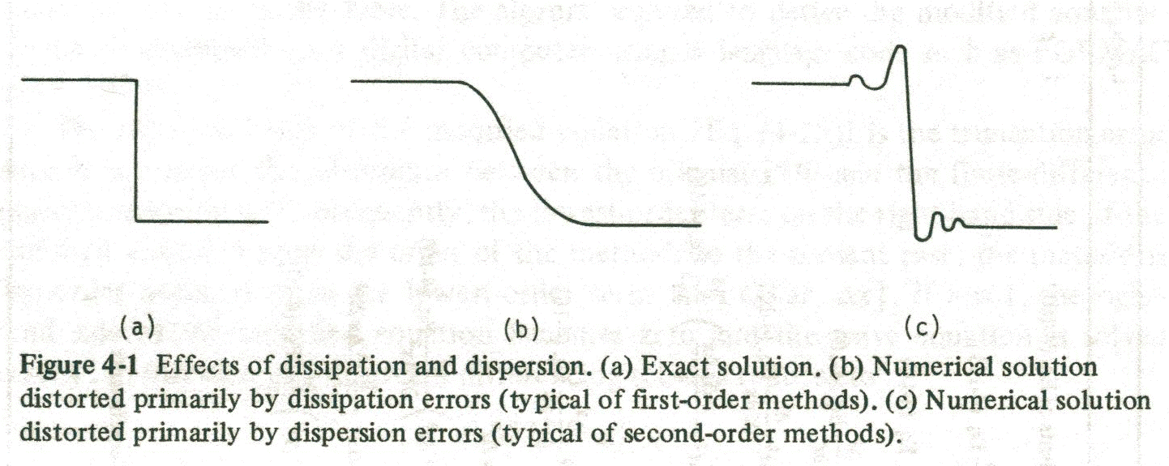
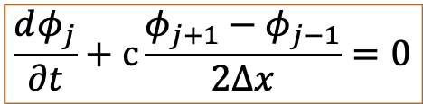
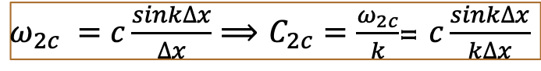
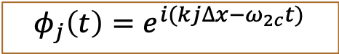
Phase Speed-Second Order
Anderson (1984)
Second-order Differential-difference space scheme
$$\frac{dφ_{j}}{∂t}+c\frac{φ_{j+1}−φ_{j−1}}{2∆x}=0$$
$ω_{2c} =c\frac{sink∆x}{∆x}⟹$ $C_{2c}=\frac{ω_{2c}}{k}$= $c\frac{sink∆x}{k∆x}$
$$φ_{j}\left(t\right)=e^{i(kj∆x−ω_{2c}t)}$$
$$Dispersive: Phase speeds depend on k$$

Slide 4
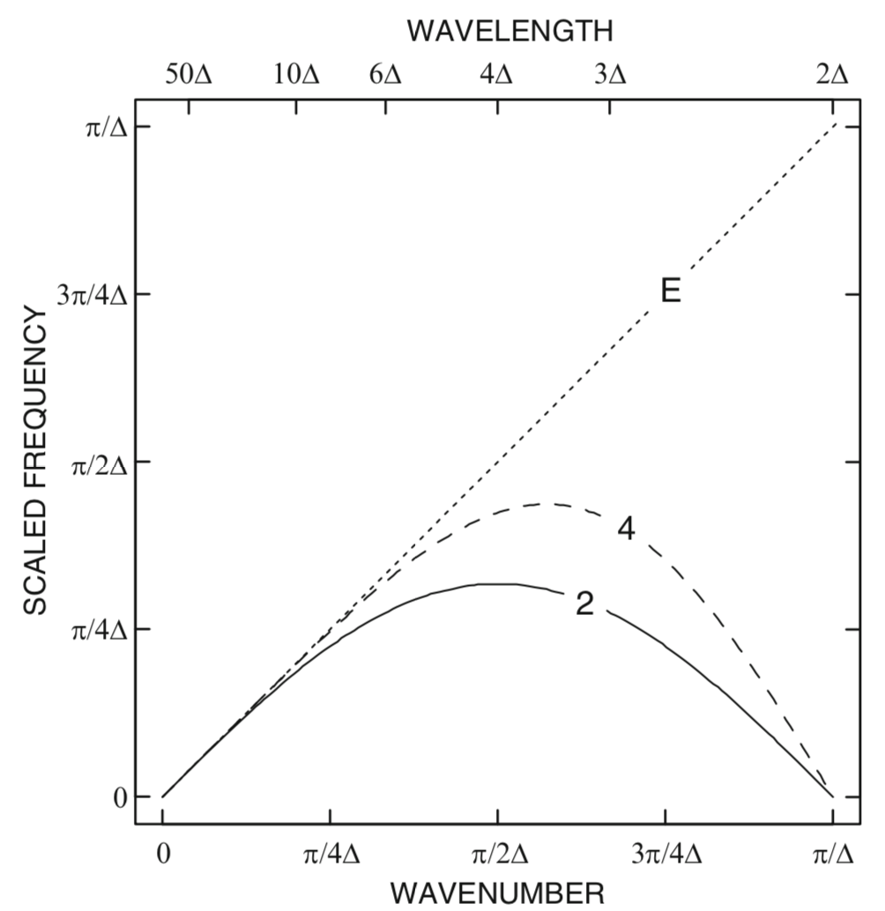
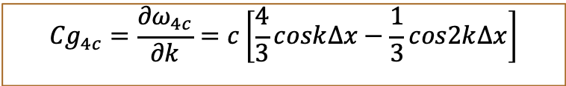
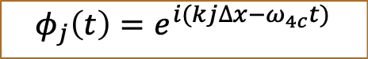
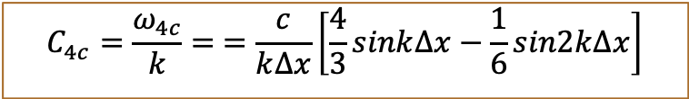
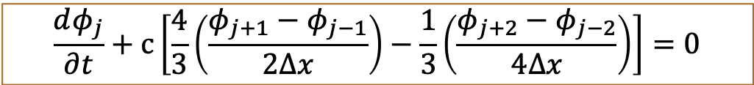
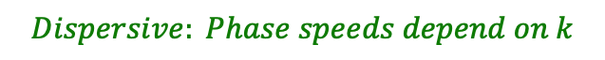
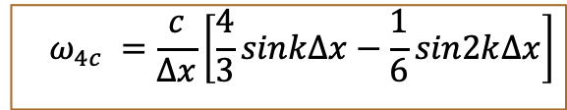
Phase Speed-Fourth Order
Fourth-order space difference scheme
$$\frac{dφ_{j}}{∂t}+c\left[\frac{4}{3}\left(\frac{φ_{j+1}−φ_{j−1}}{2∆x}\right)−\frac{1}{3}\left(\frac{φ_{j+2}−φ_{j−2}}{4∆x}\right)\right]=0$$
$$φ_{j}\left(t\right)=e^{i(kj∆x−ω_{4c}t)}$$
$$ω_{4c} =\frac{c}{∆x}\left[\frac{4}{3}sink∆x−\frac{1}{6}sin2k∆x\right]$$
Fig 3.2. in Durran’s book
$$Dispersive: Phase speeds depend on k$$
Phase speed:
$$C_{4c}=\frac{ω_{4c}}{k}= =\frac{c}{k∆x}\left[\frac{4}{3}sink∆x−\frac{1}{6}sin2k∆x\right]$$
Group speed:
$${Cg}_{4c}=\frac{{∂ω}_{4c}}{∂k}=c\left[\frac{4}{3}cosk∆x−\frac{1}{3}cos2k∆x\right]$$

Slide 5
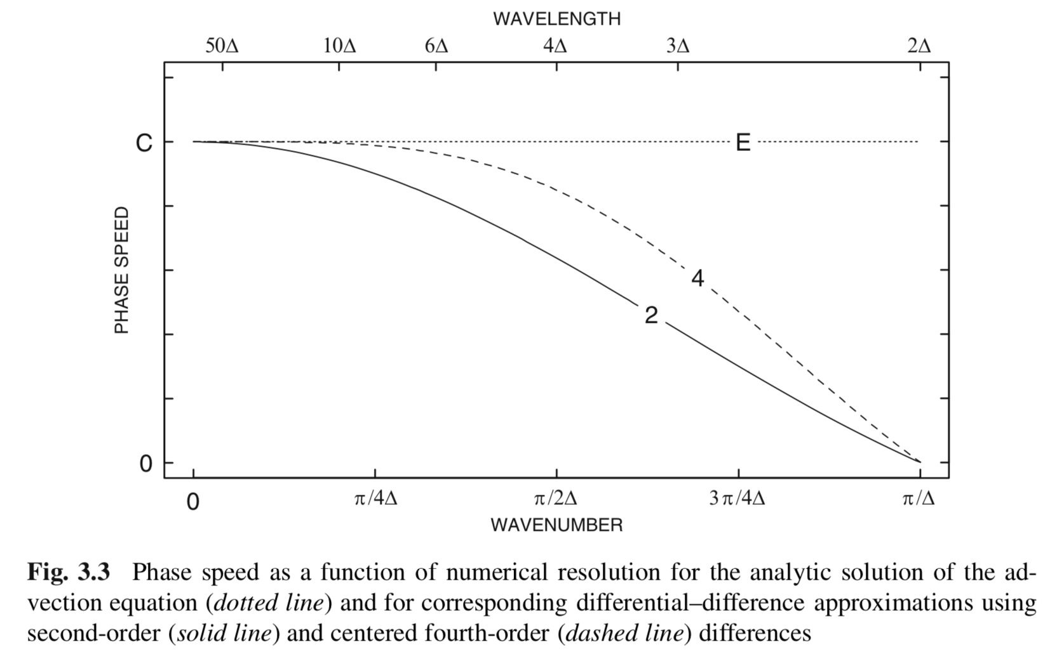
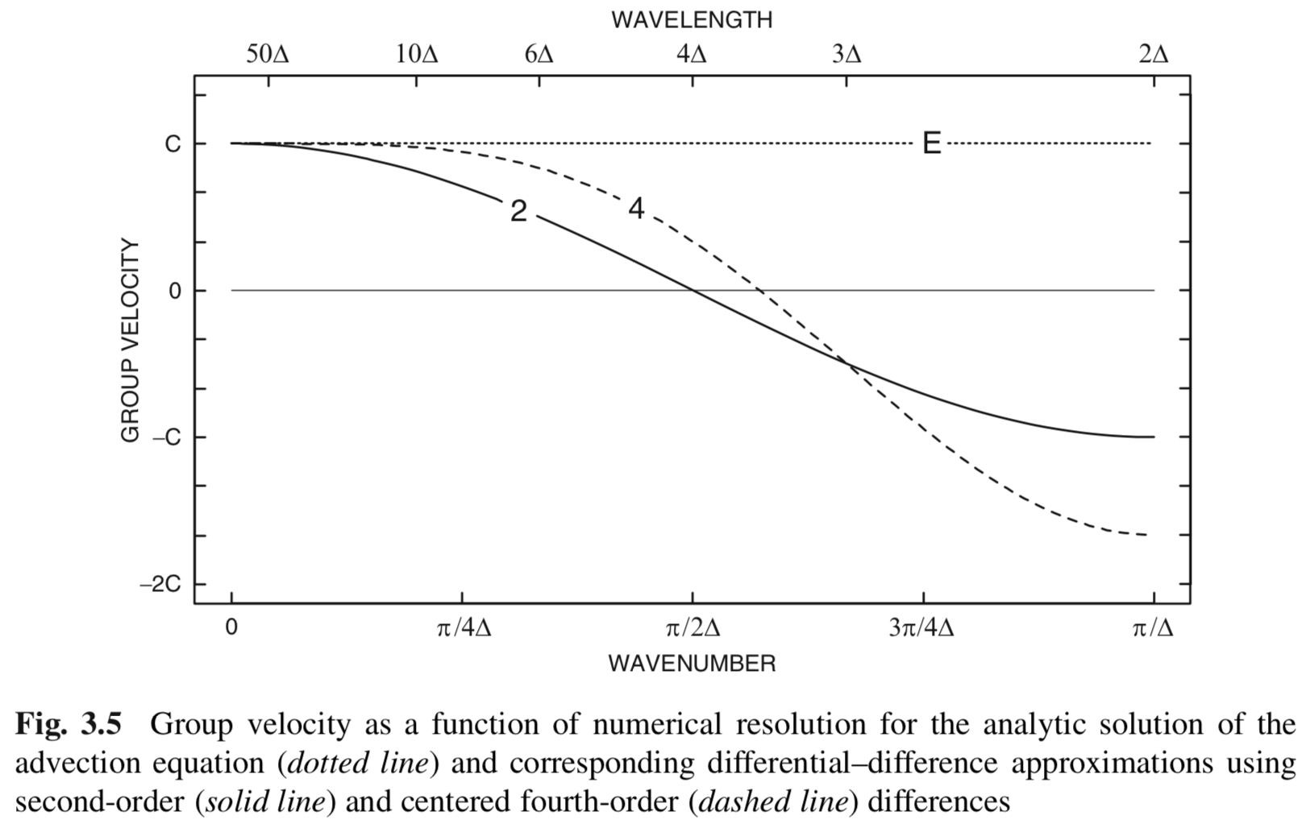
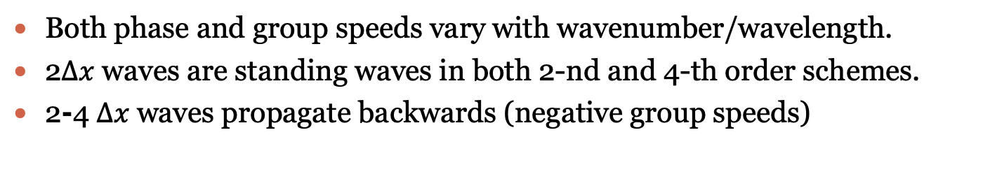
Phase Speed & Group Speed
Phase speed
Group speed
Fig 3.3. in Durran’s book
Fig 3.5. in Durran’s book
Both phase and group speeds vary with wavenumber/wavelength.
2$∆x$ waves are standing waves in both 2-nd and 4-th order schemes.
2⁃4 $∆x$waves propagate backwards (negative group speeds)

Slide 6
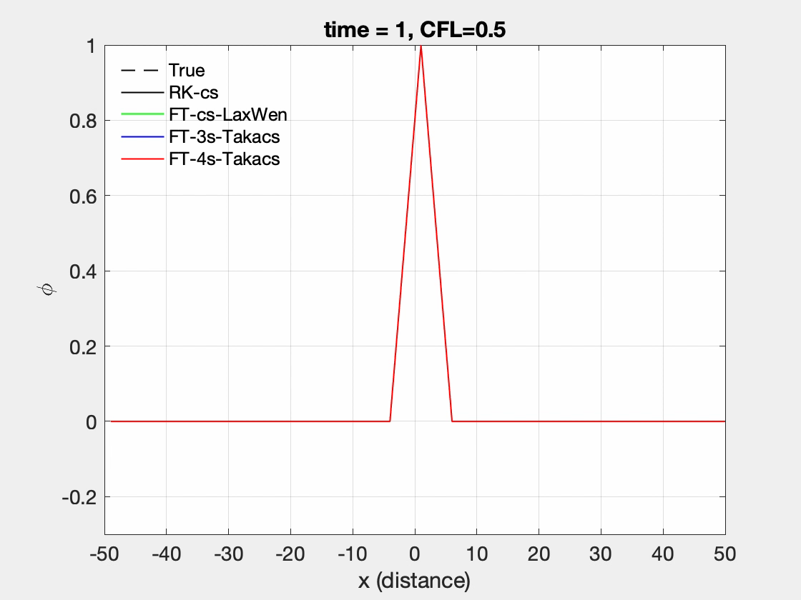
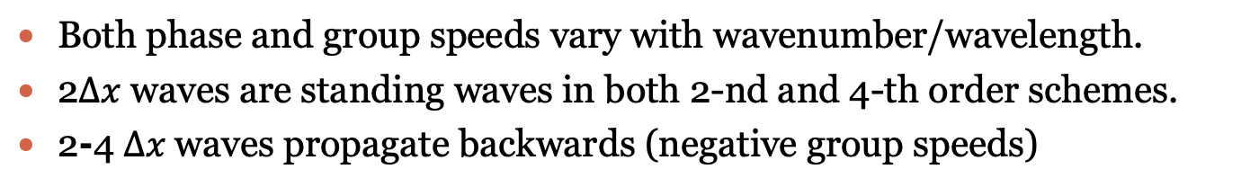
Both phase and group speeds vary with wavenumber/wavelength.
2$∆x$ waves are standing waves in both 2-nd and 4-th order schemes.
2⁃4 $∆x$waves propagate backwards (negative group speeds)

Slide 7

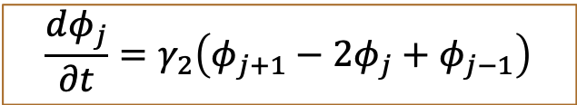

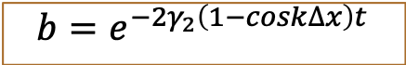
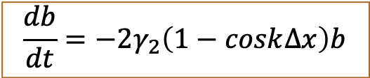
Spatial Filtering
Add scale-selective dissipation to otherwise non-dissipative schemes to damp the shortest resolvable wavelengths
Nonlinear problems, necessary to remove energy from the shortest spatial scales to prevent the development of numerical instabilities.
Second-derivative smoother
$$\frac{dφ_{j}}{∂t}=γ_{2}\left(φ_{j+1}−2φ_{j}+φ_{j−1}\right)$$
$$\frac{db}{dt}=−2γ_{2}\left(1−cosk∆x\right)b$$
$$φ_{j}=b\left(t\right)e^{ikx}=b\left(t\right)e^{ikj∆x}$$
Damping rate (e-folding rate)
For 2$∆x$, damping rate is the greatest.
$$b=e^{−2γ_{2}\left(1−cosk∆x\right)t}$$

Slide 8
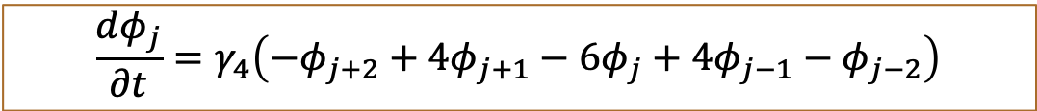
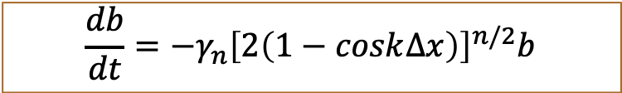

Higher-derivative Filtering
4th-derivative smoother
$$\frac{dφ_{j}}{∂t}=γ_{4}\left(−φ_{j+2}+4φ_{j+1}−6φ_{j}+4φ_{j−1}−φ_{j−2}\right)$$
6th-derivative smoother
$$\frac{dφ_{j}}{∂t}=γ_{6}\left(φ_{j+3}−6φ_{j+2}+15φ_{j+1}−20φ_{j}+15φ_{j−1}−6φ_{j−2}+φ_{j−3}\right)$$
$$φ_{j}=b\left(t\right)e^{ikx}=b\left(t\right)e^{ikj∆x}$$
Generalized damping factor for n^{th}-derivative smoother
$$\frac{db}{dt}=−γ_{n}{\left[2\left(1−cosk∆x\right)\right]}^{n/2}b$$
Damping rate (e-folding rate)

Slide 9
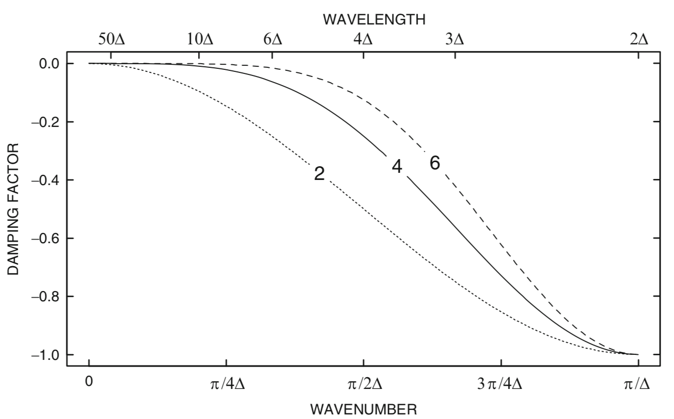
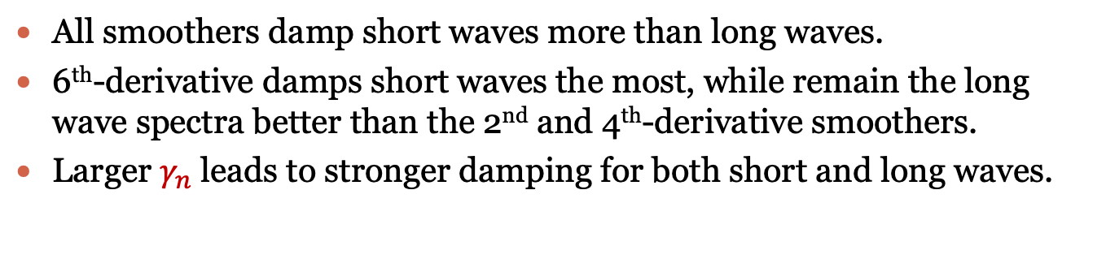
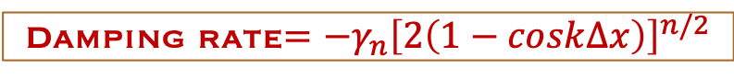
Damping rate$=−γ_{n}{\left[2\left(1−cosk∆x\right)\right]}^{n/2}$
Fig 3.8. in Durran’s book
All smoothers damp short waves more than long waves.
6th-derivative damps short waves the most, while remain the long wave spectra better than the 2nd and 4th-derivative smoothers.
Larger $γ_{n}$ leads to stronger damping for both short and long waves.

Slide 10
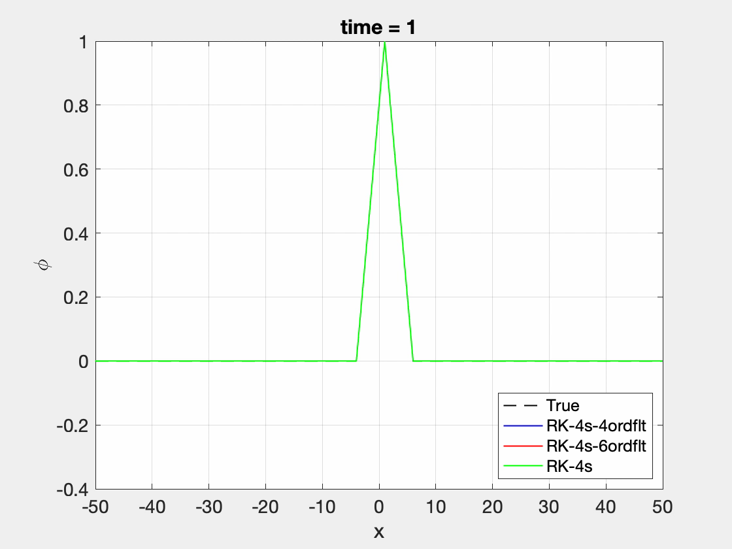
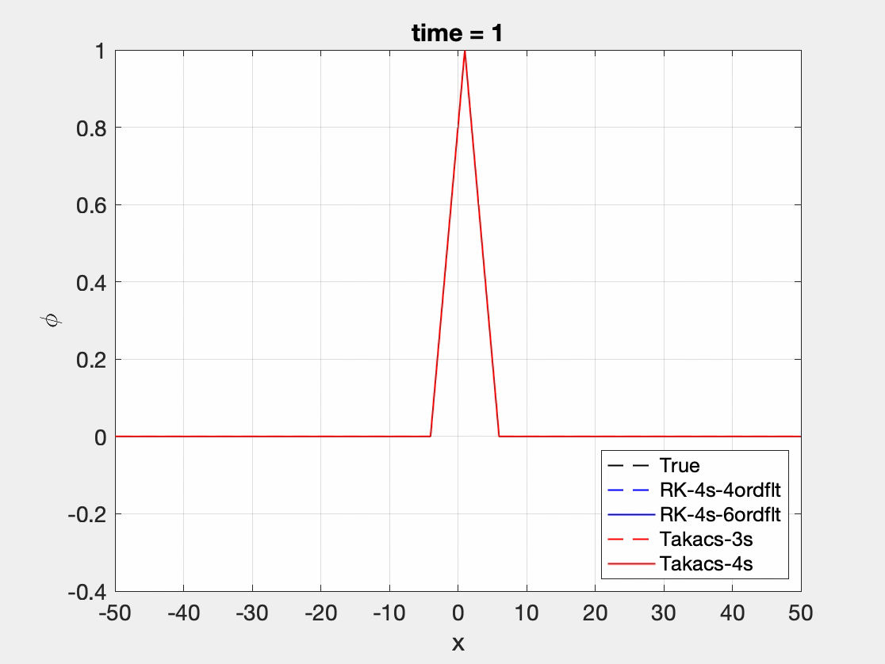
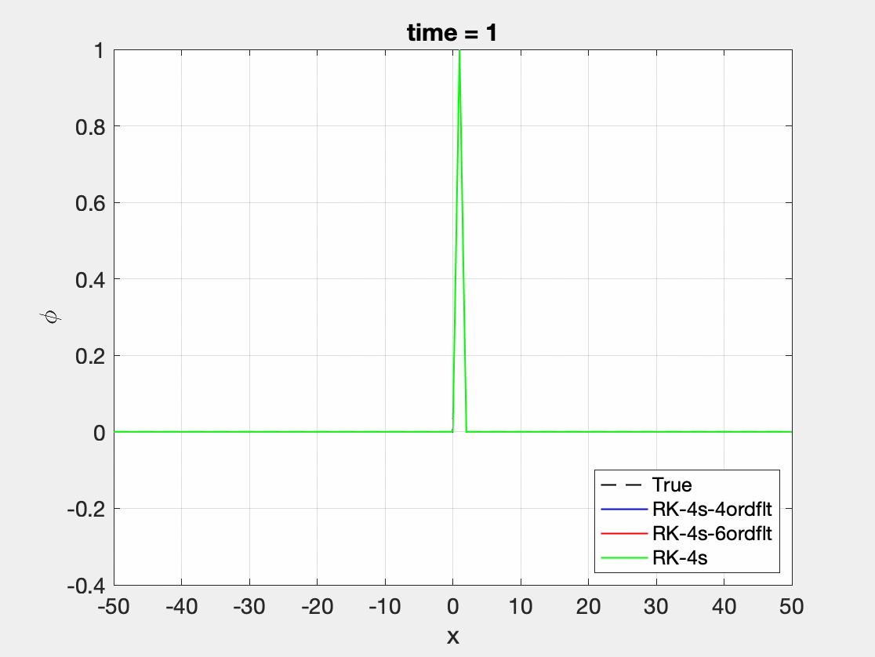
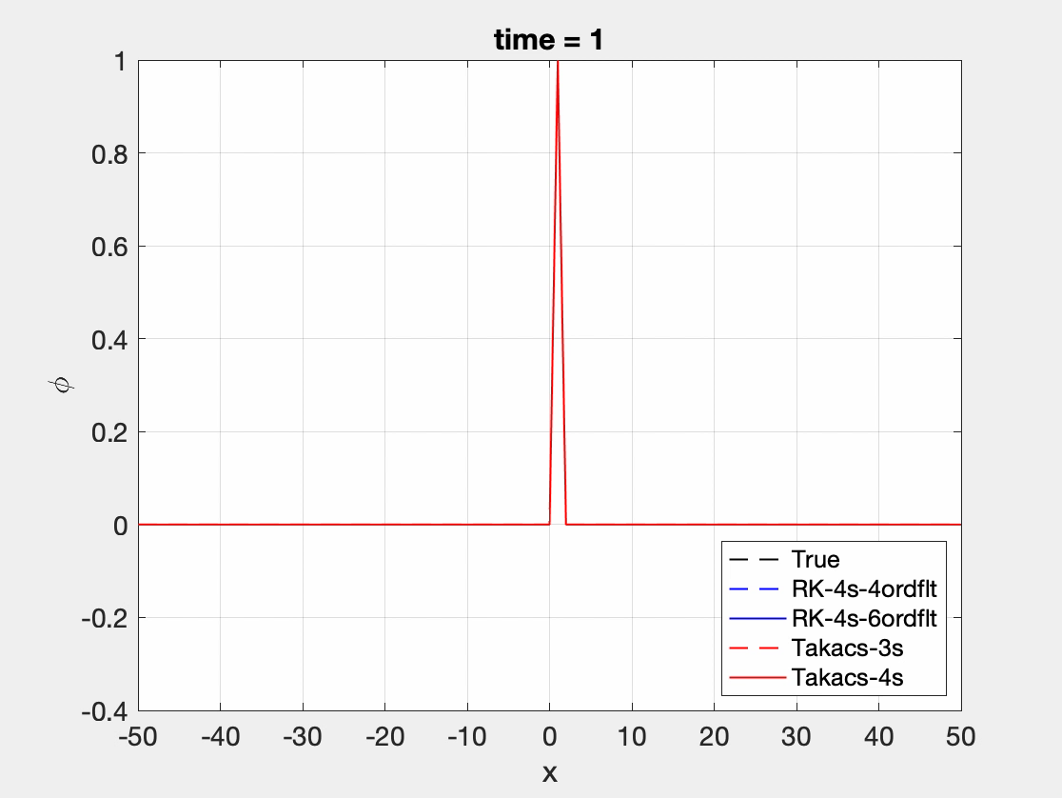
Tri (Space Filt)
Tri (SF vs. Takacs)
Spike (Space Filt)
Spike (SF vs. Takacs)

Slide 11
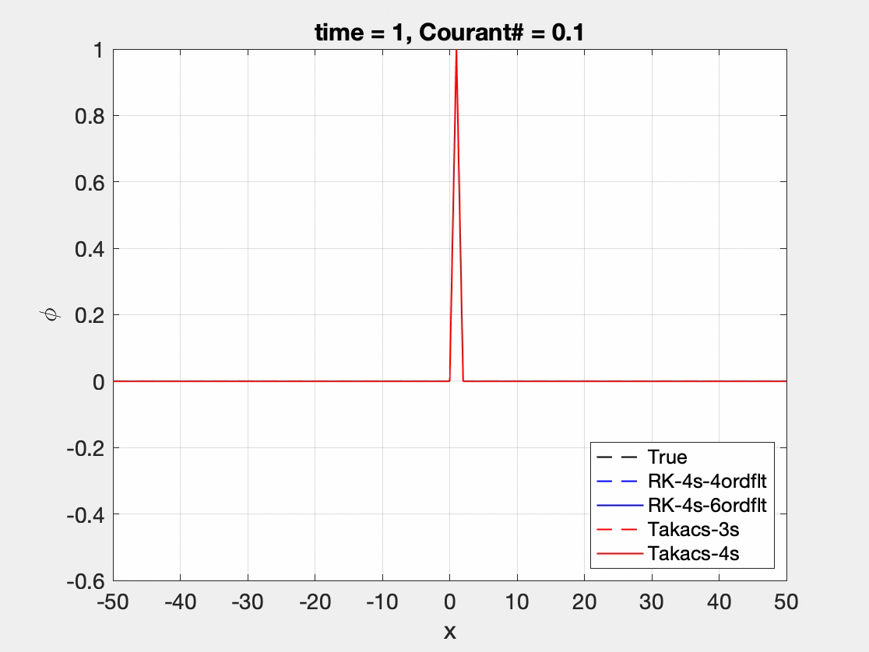

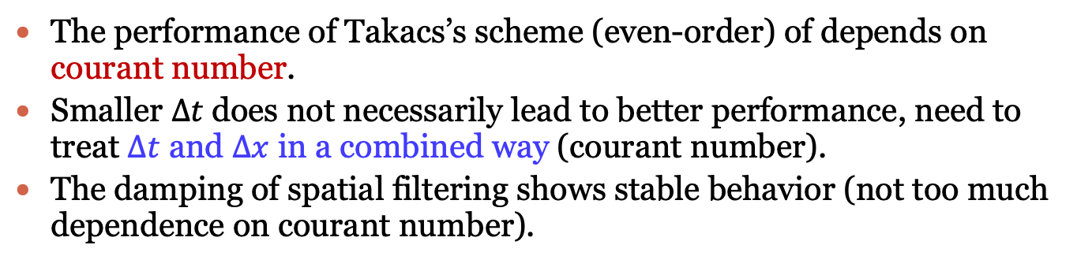
Revisit of Takacs’ Scheme
The performance of Takacs’s scheme (even-order) of depends on courant number.
Smaller $∆t$does not necessarily lead to better performance, need to treat $∆t$ and $∆x$ in a combined way (courant number).
The damping of spatial filtering shows stable behavior (not too much dependence on courant number).

Slide 12
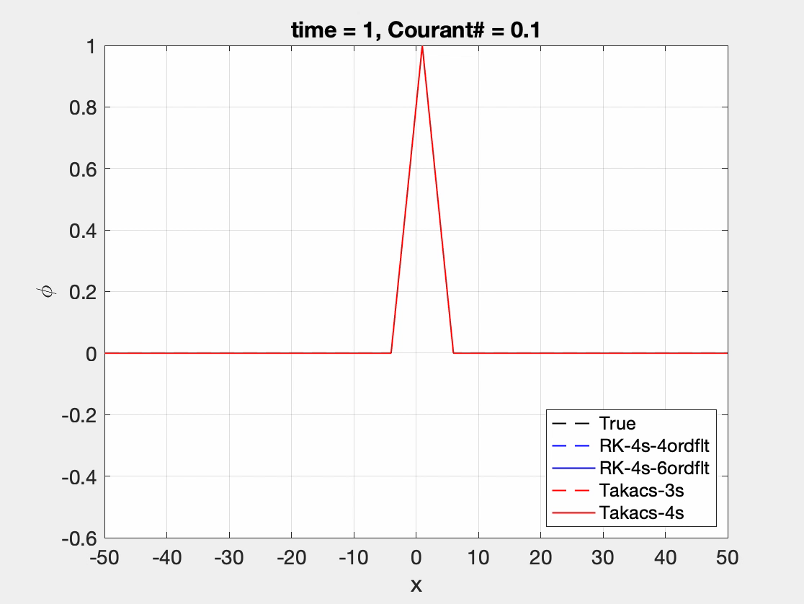
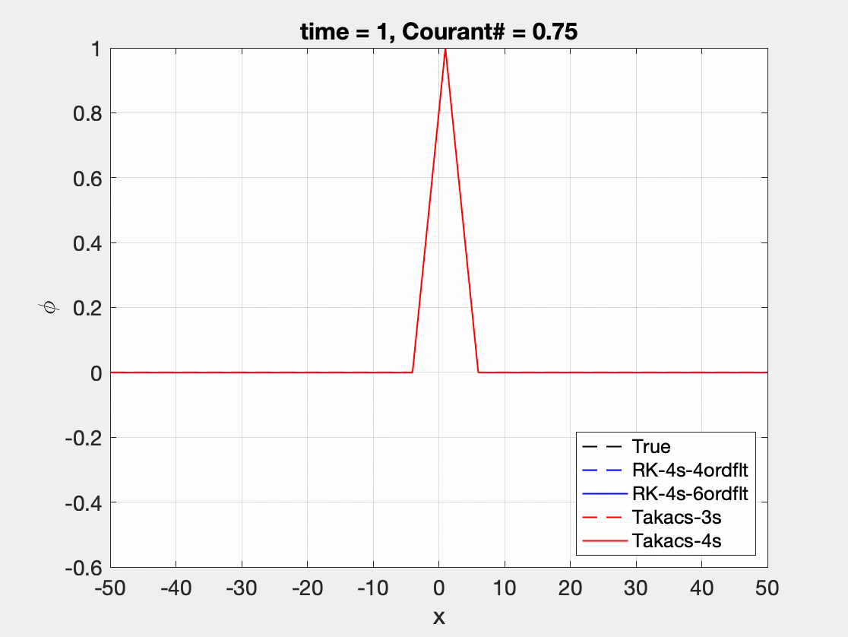
Revisit of Takacs’ Scheme
Main conclusions are similar as previous slide.
If the true solution contains larger amplitude of short-wavelength waves, the performance of Takacs’s schemes (even-order) degrades more significantly across different courant numbers.

Slide 13
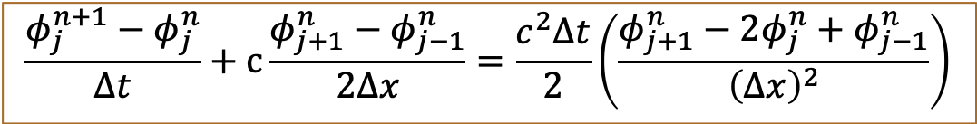
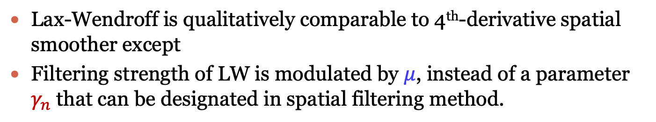
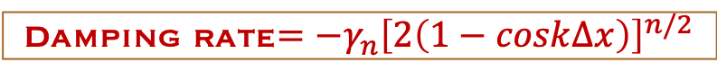
Lax-Wendroff Scheme
Finite Difference Scheme
$$\frac{φ_{j}^{n+1}−φ_{j}^{n}}{∆t}+c\frac{φ_{j+1}^{n}−φ_{j−1}^{n}}{2∆x}=\frac{c^{2}∆t}{2}\left(\frac{φ_{j+1}^{n}−2φ_{j}^{n}+φ_{j−1}^{n}}{{\left(∆x\right)}^{2}}\right)$$
Amplification Factor
$${\left|A\right|}^{2}=1−μ^{2}\left(1−μ^{2}\right){\left(1−cosk∆x\right)}^{2}$$
n^{th}-derivative smoother
Damping rate$=−γ_{n}{\left[2\left(1−cosk∆x\right)\right]}^{n/2}$
Lax-Wendroff is qualitatively comparable to 4th-derivative spatial smoother except
Filtering strength of LW is modulated by $μ$, instead of a parameter $γ_{n}$that can be designated in spatial filtering method.

Slide 14
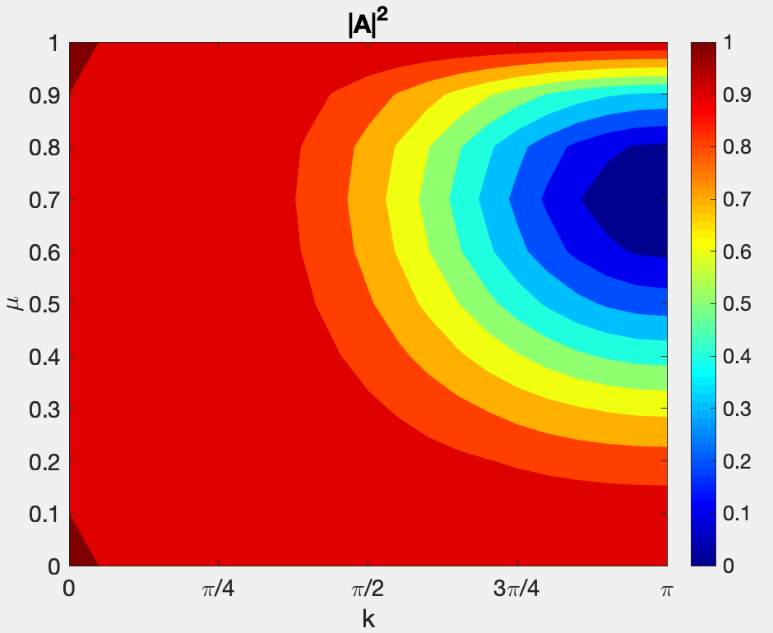
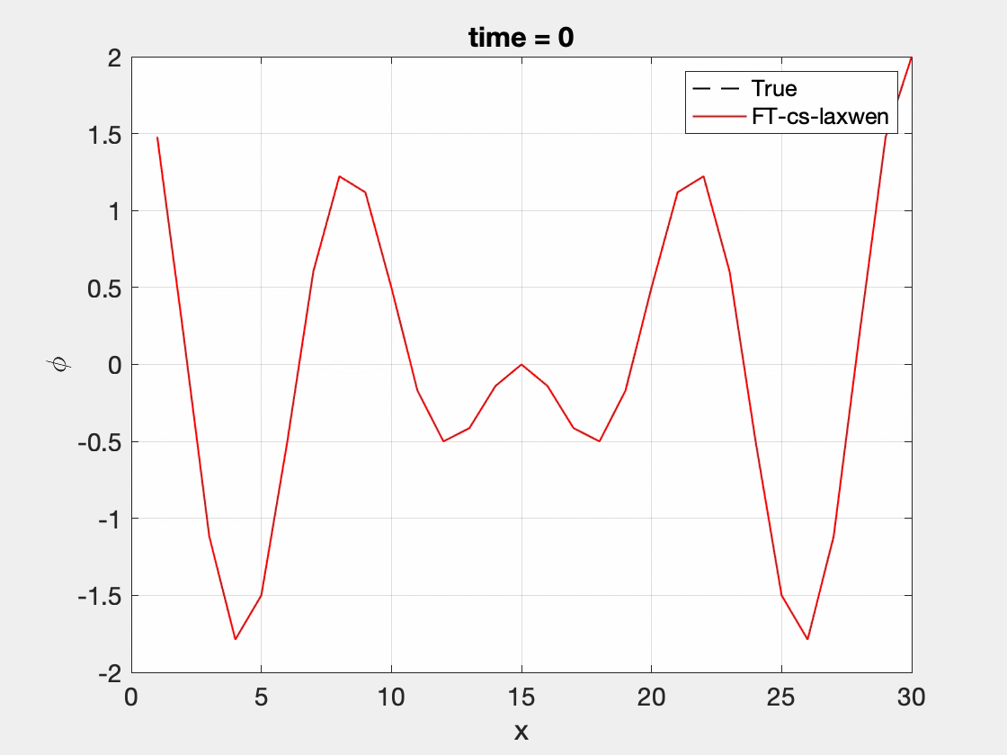
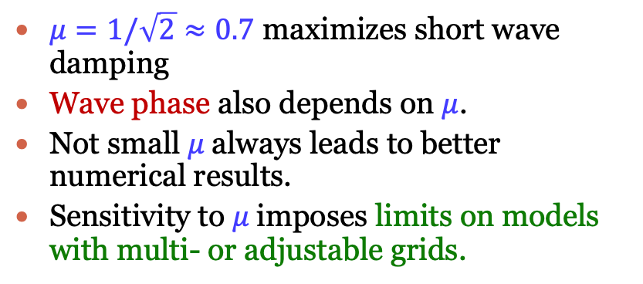


Revisit of Takacs’ Scheme
Small Damping
$$μ=0.1$$
Large Damping
Small Damping
$$μ=0.7$$
$μ=1/\sqrt{2}≈0.7$ maximizes short wave damping
Wave phase also depends on $μ$.
Not small $μ$always leads to better numerical results.
Sensitivity to $μ$imposes limits on models with multi- or adjustable grids.

